Slide 1
Hospital Management System

Slide 2
Objectives
Project Understanding
Use Case Diagram
Sequence Diagram
Class Diagram
Screenshots
Opportunity for improvement

Slide 3
Project Details
Hospital Management System incorporates various factors needed for working and management of a hospital.
It includes registration of patients, reporting their labs, billing Managing Labs, and other various modules in hospital .
Admin can update and search required details of patient and Doctor.
Developing a customized Hospital Management system will not only save time and cost but will also generate reports to improve efficiency.

Slide 4
Project Details
Phase 1 : Using Console Application.
Phase 2 : Using ADO.NET using WPF
Phase 3 : Using ASP.NET MVC.

Slide 5
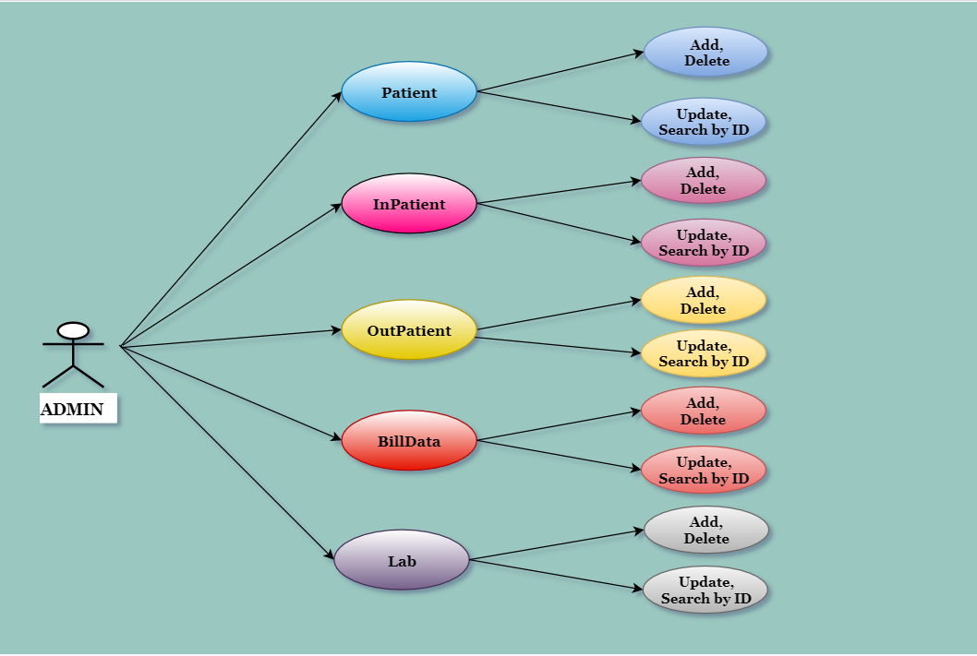
Use Case Diagram

Slide 6
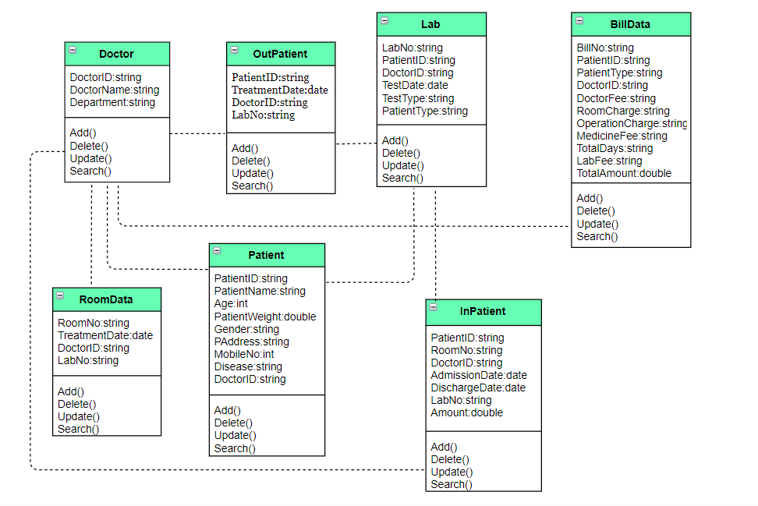
Class Diagram

Slide 7
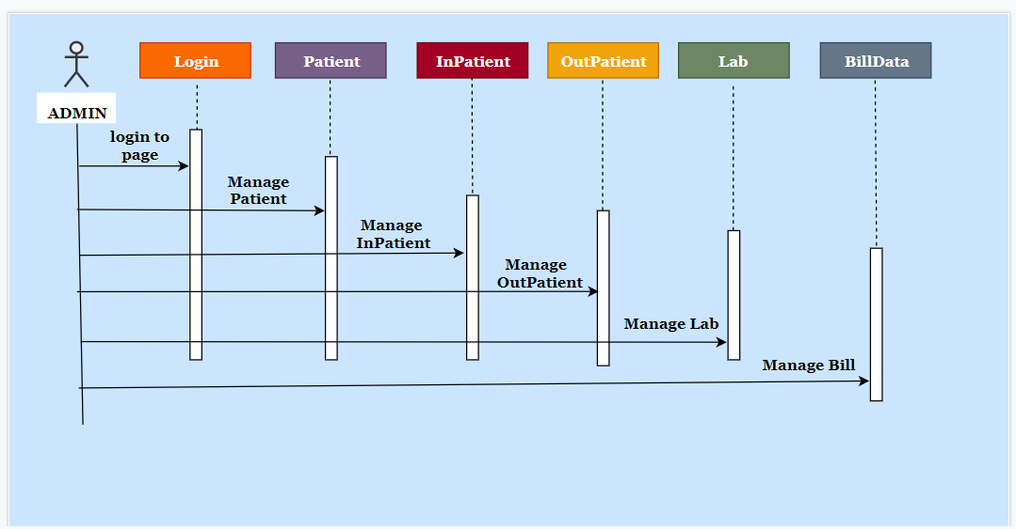
Sequence/Activity Diagram

Slide 8
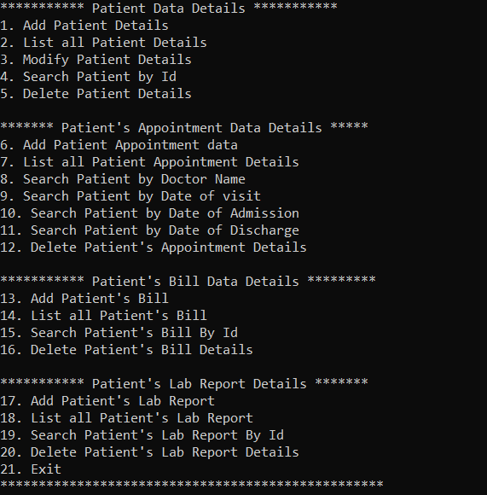
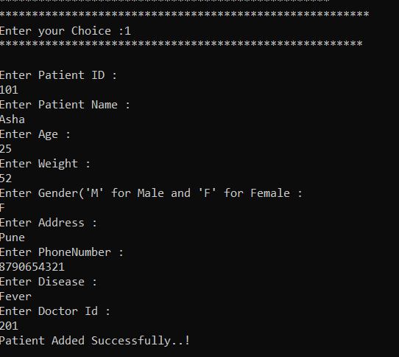
Screen shots

Slide 9
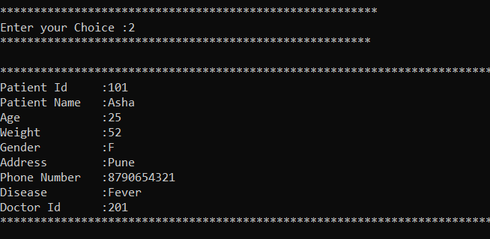
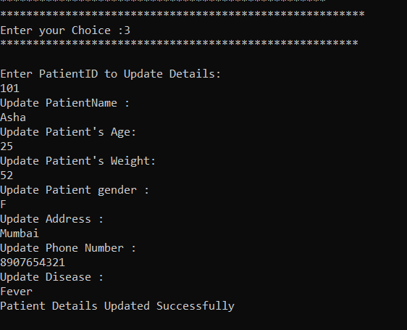
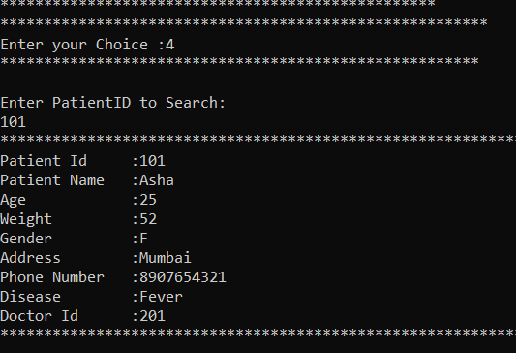
Screen shots

Slide 10
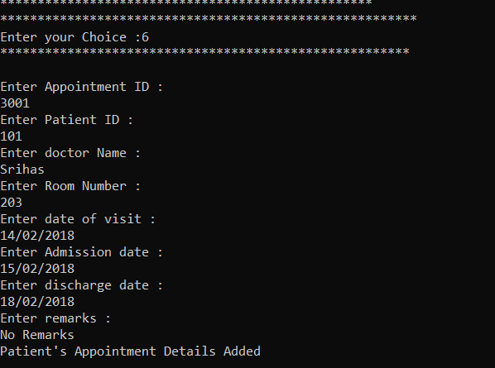
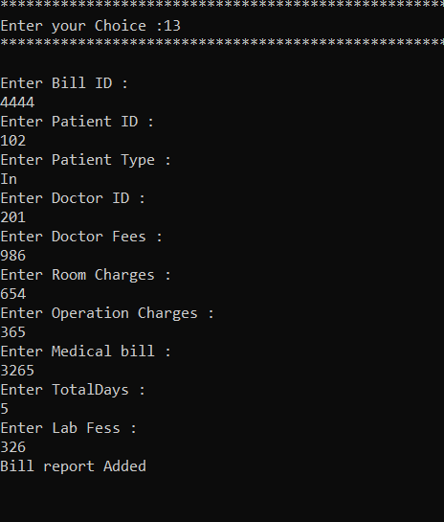
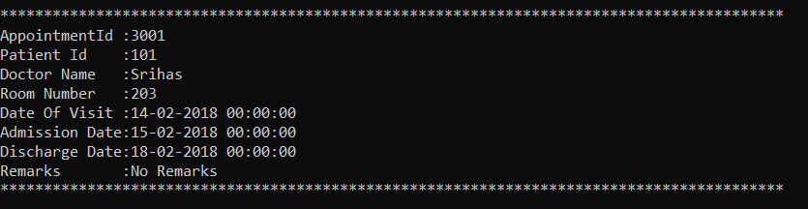
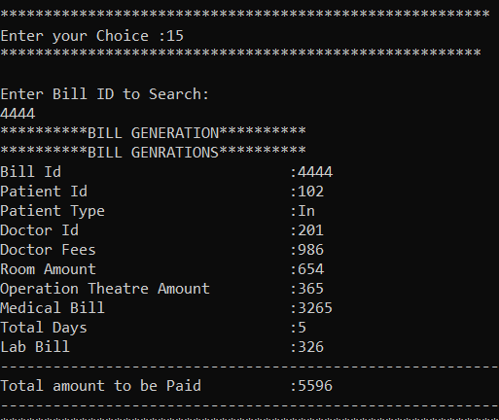
Screen shots

Slide 11

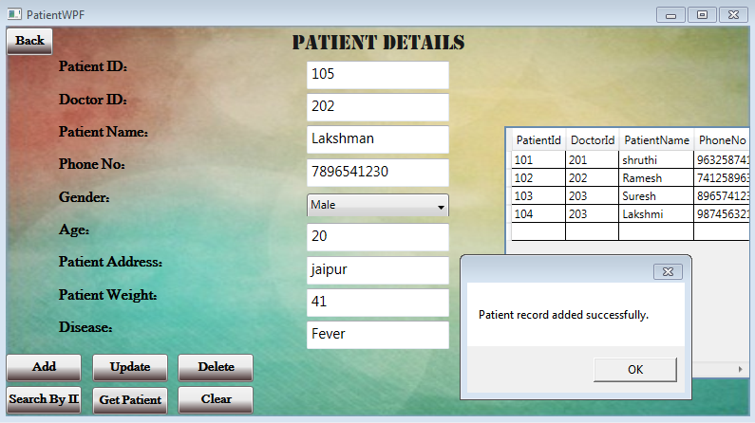
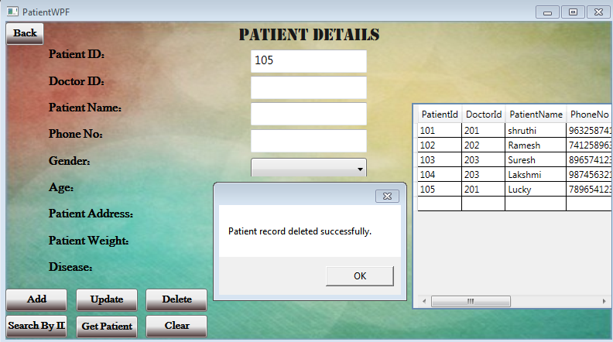
Screen shots

Slide 12
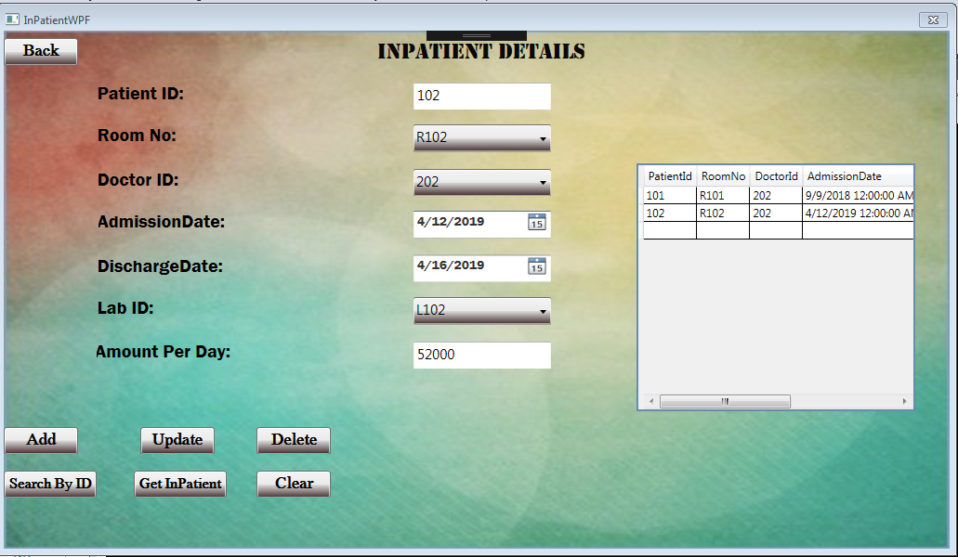
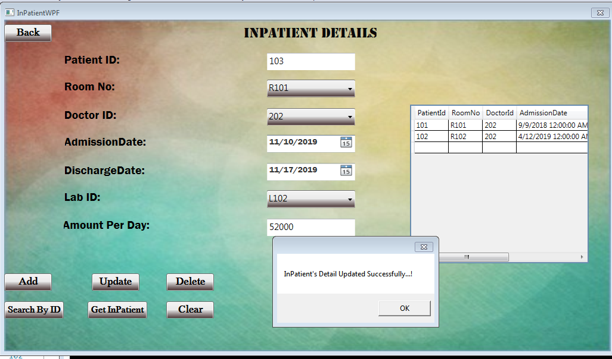
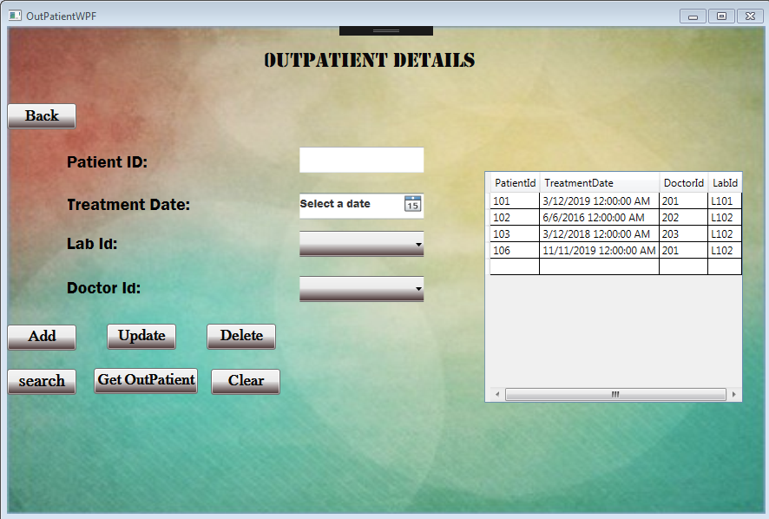
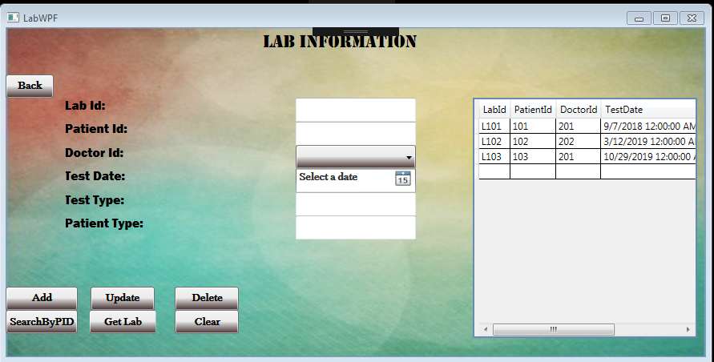
Screen shots

Slide 13
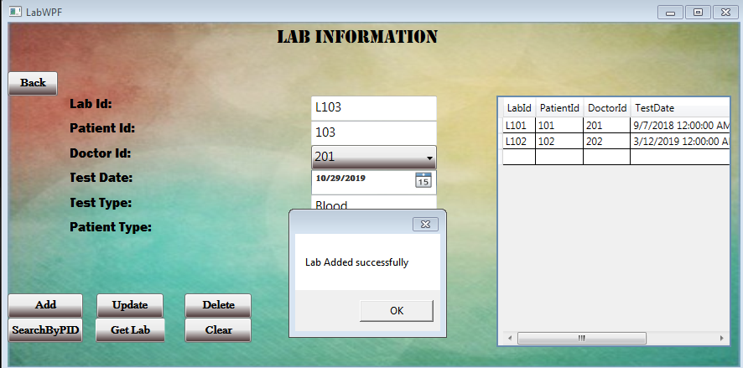
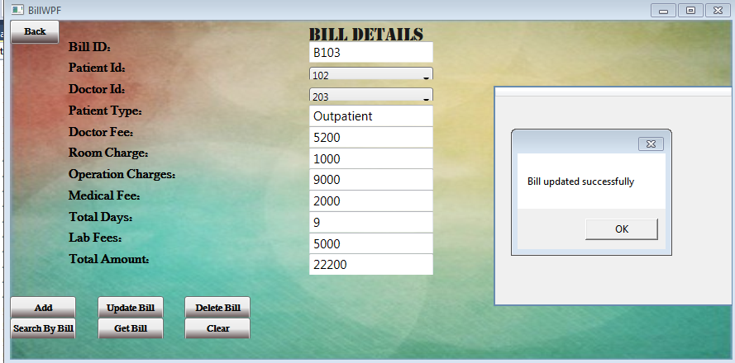
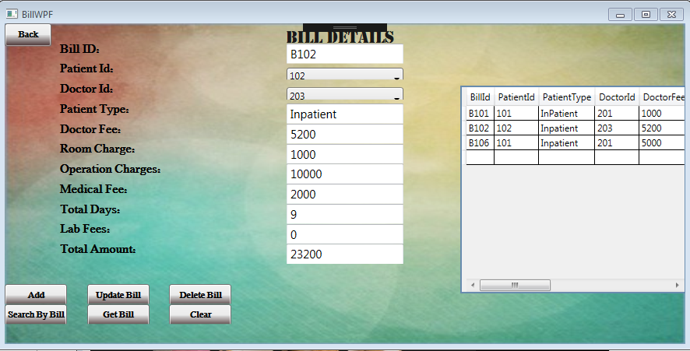
Screen shots

Slide 14
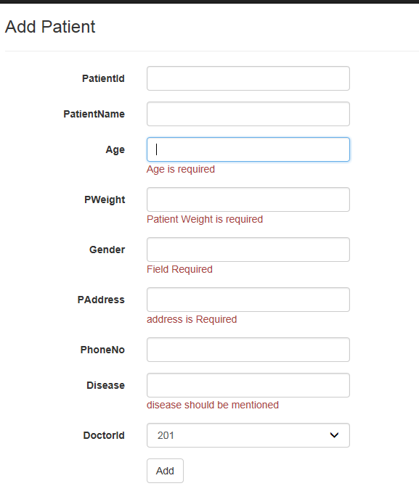
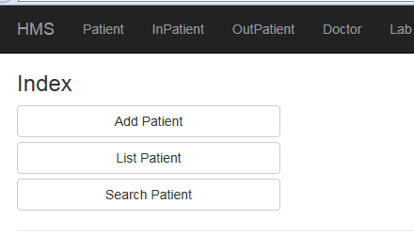
Screen Shots

Slide 15
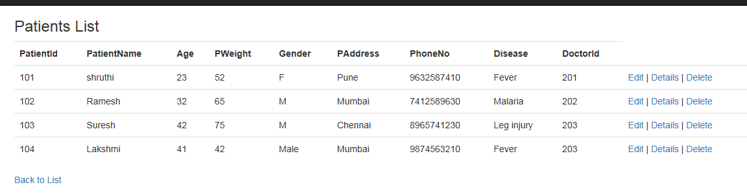
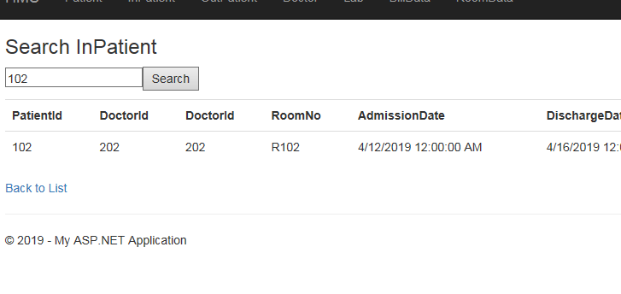
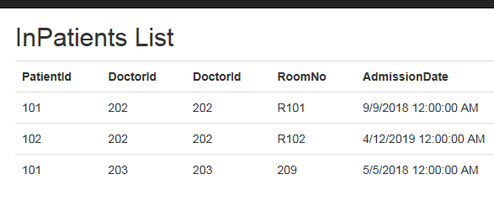
Screen Shots

Slide 16
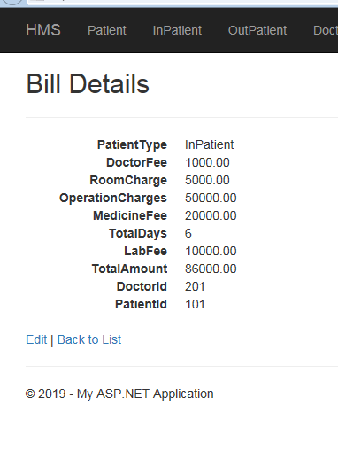
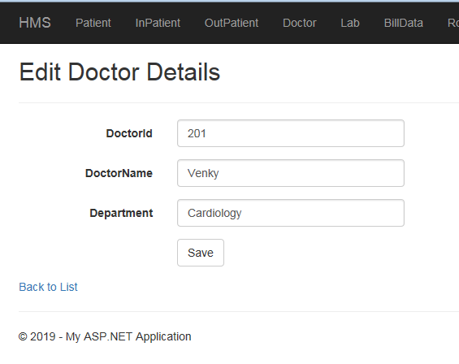
Screen Shots

Slide 17
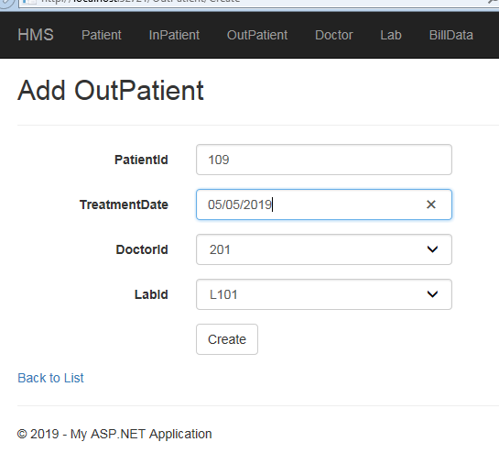
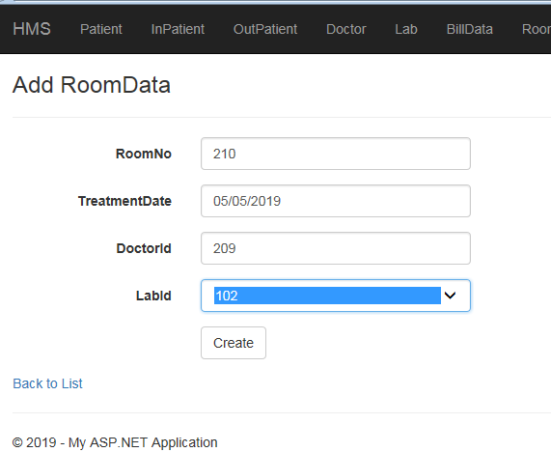
Screen Shots

Slide 18
Future Enhancements
In this Project, We can future develop
By implementing the storage of information about various diseases and medicines which are available to cure them.
By providing prescription, precautions and Diet advice.

Slide 19
Thanks

